Slide 1

Department of Computer Science and Engineering
TECHNICAL SEMINAR ON
GAMING CONSOLES
Seminar Guide: Presented By:
Mrs. Sunitha T N Kishan Kumar
Asst. Prof, CSE,RGIT (1RG15CS018)

Slide 2
ABSTRACT
A gaming console is a system that is exclusively dedicated for gaming.
It has been optimized for game playing as that is its core function.
We can play games on a PC or in a cell phone but these are not systems dedicated for gaming, so they are not gaming consoles.

Slide 3
INTRODUCTION
Gaming consoles were designed for playing electronic games. A gaming console is a highly specialized piece of hardware
that has rapidly evolved since its inception incorporating all the latest advancements in processor technology, memory,graphics, and sound among others to give the gamer the ultimate gaming experience.
• Video games are most often found on video gaming consoles that plug into your television.

Slide 4
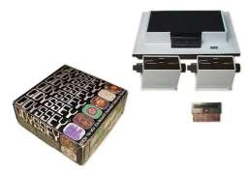
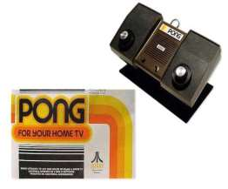
HISTORY
First Generation Games :
Magnavox Odyssey Released in 1972.
Magnavox Odyssey is first game console.
Poor marketing caused it to fail.
Second generation Games : ▪Atari PONG Released in 1975
Improved version of ‘Magnavox Odyssey’.

Slide 5
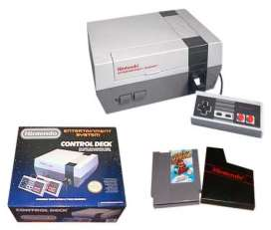
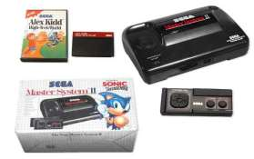
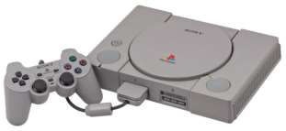
.
Third Generation Games :
Nintendo Entertainment System (NES) debuts.
Released in 1985.
Fourth Generation Games :
Sega Master System II.
Fifth Generation Games :
Sony Playstation

Slide 6
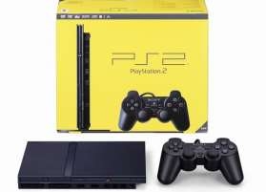
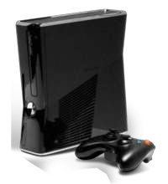
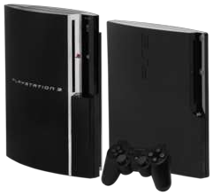
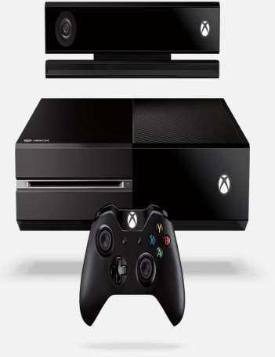
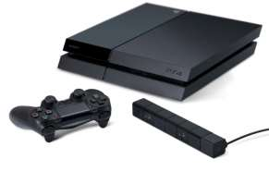
.
Sixth Generation Games :
Sony Playstation II
Seventh Generation Games :
Microsoft Xbox 360
Sony Playstation 3
Eighth Generation Games :
Microsoft Xbox One
Sony Playstation 4

Slide 7
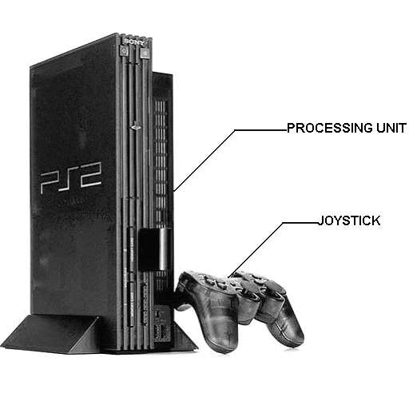
A Typical Game Console

Slide 8
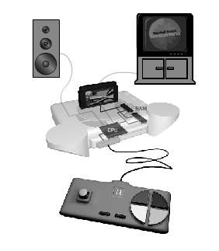
Basic Components Of Gaming Console
User control interface
CPU
RAM
Software kernel
Storage medium for games
Video output
Audio output
Power supply

Slide 9
Benefits of Gaming in Medical Point of View
Absorption in a game distracts the mind from pain and discomfort.
Playing games could help children suffering from Attention deficit disorders.
Games help people who are recovery from physical injuries gain motorskills and coordination too. Now doctors are using in physiotherapy too.
It helps players to improve hand-eye co-ordination and help players gain many skills.
Modern fast-paced action video games in particular first-person shootergames may sharpen your vision, improve your attention and workingmemory

Slide 10
Advantages &Disadvantages Of Gaming Console
Advantages
Cheaper than a gaming PC
Updates for console games come in first before pc games get updated.
No need to worry about hardware upgrades.
first person shooter experiences for games like call of duty and battlefield.
▪

Slide 11
Disadvantages
▪ Low quality graphics compared to Gaming pc
▪ Expensive games
▪ Pay for multiplayer

Slide 12
CONCLUSION
On the whole gaming consoles are the better option in the long run. After
all they are designed for gaming right from scratch. This has helped the
industry understand the basic requirements of 3D and multimedia
applications.

Slide 13

THANK YOU

